Slide 1
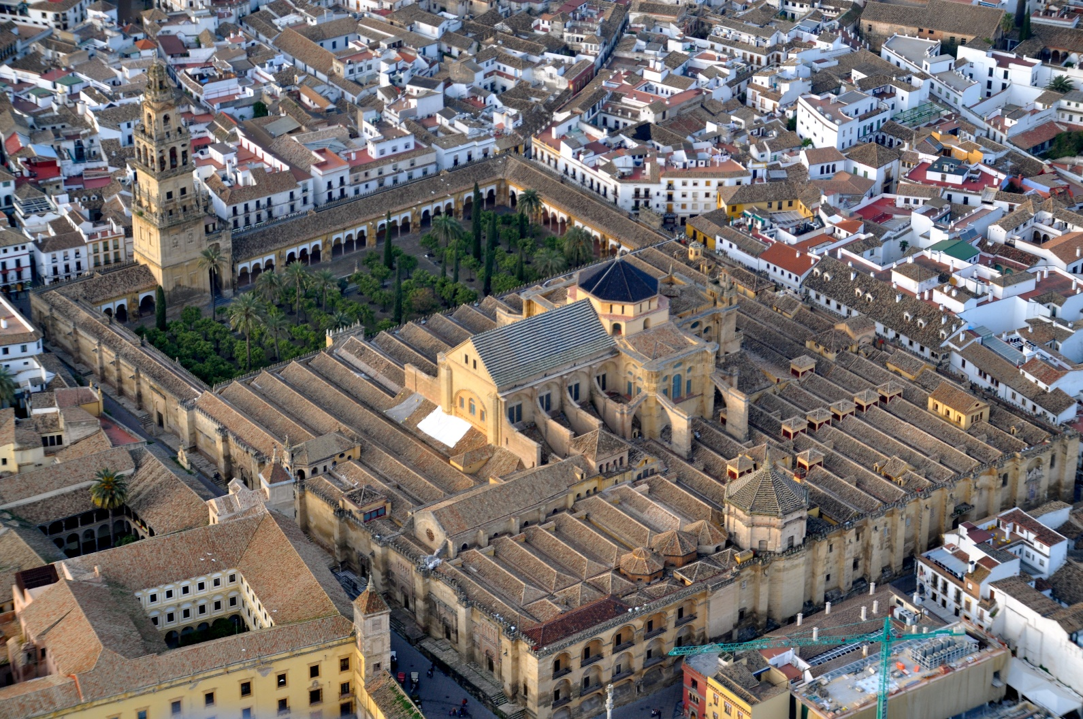
Mosque–Cathedral of Córdoba
Mezquita-Catedral de Córdoba

Slide 2
Mosque–Cathedral of Córdoba
The Mosque–Cathedral of Córdoba (Spanish: Mezquita-Catedral de Córdoba) is the cathedral of the Roman Catholic Diocese of Córdoba dedicated to the Assumption of Mary and located in the Spanish region of Andalusia.
Due to its status as a former Islamic mosque, it is also known as the Mezquita ('mosque' in Spanish) and as the Great Mosque of Córdoba.

Slide 3
Mosque–Cathedral of Córdoba
Historians believe that there had first been a temple to the Roman god, Janus, on this site.
The temple was converted into a church by invading Visigoths who seized Córdoba in 572.
Next, the church was converted into The Great Mosque and then completely rebuilt on the orders of Abd ar-Rahman I in 785.
The mosque was then converted into a cathedral in 1236 when Córdoba was captured by the Christian forces of Castile during the Reconquista.

Slide 4
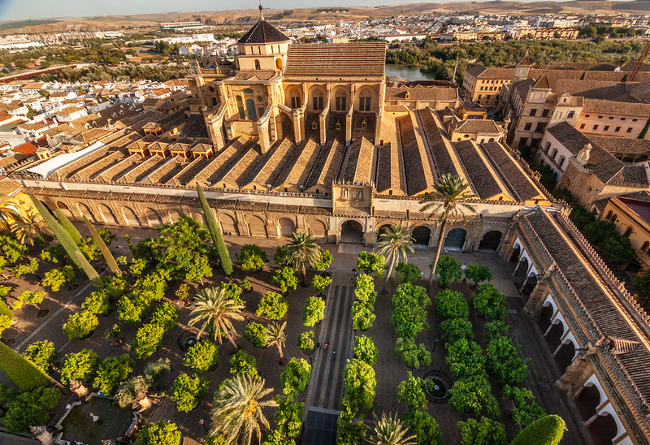
Mosque–Cathedral of Córdoba
The mosque structure is an important monument in the history of Islamic architecture, which we can see in the following pictures of exterior and interior

Slide 5
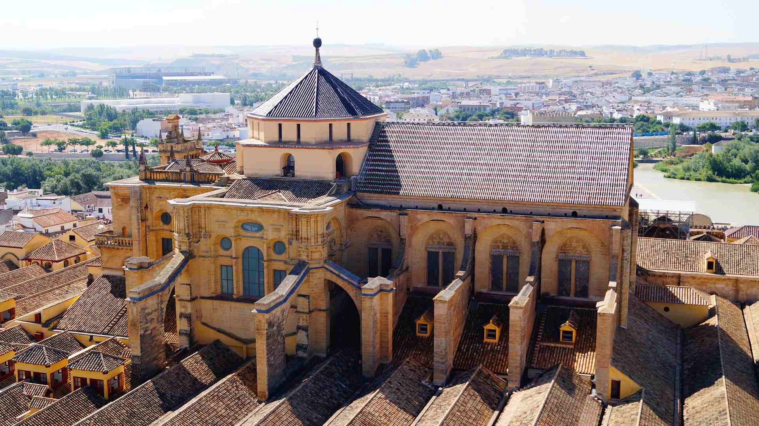
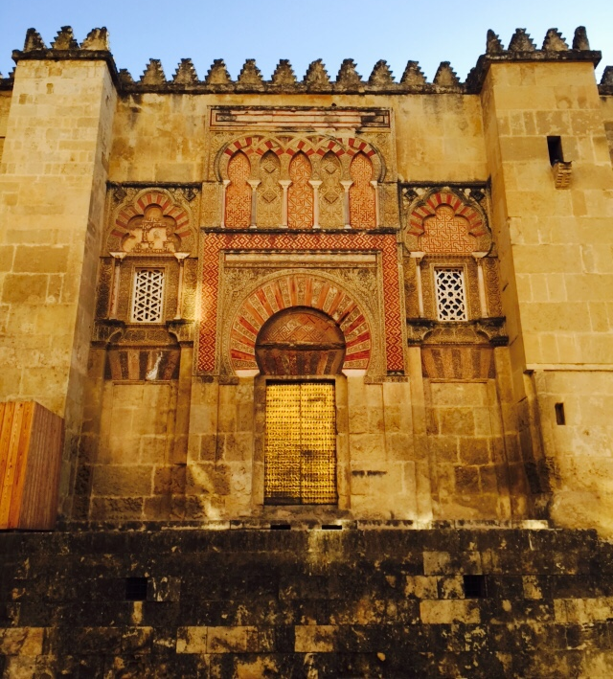
Mosque–Cathedral of Córdoba
Caliphal entrance on the west side

Slide 6
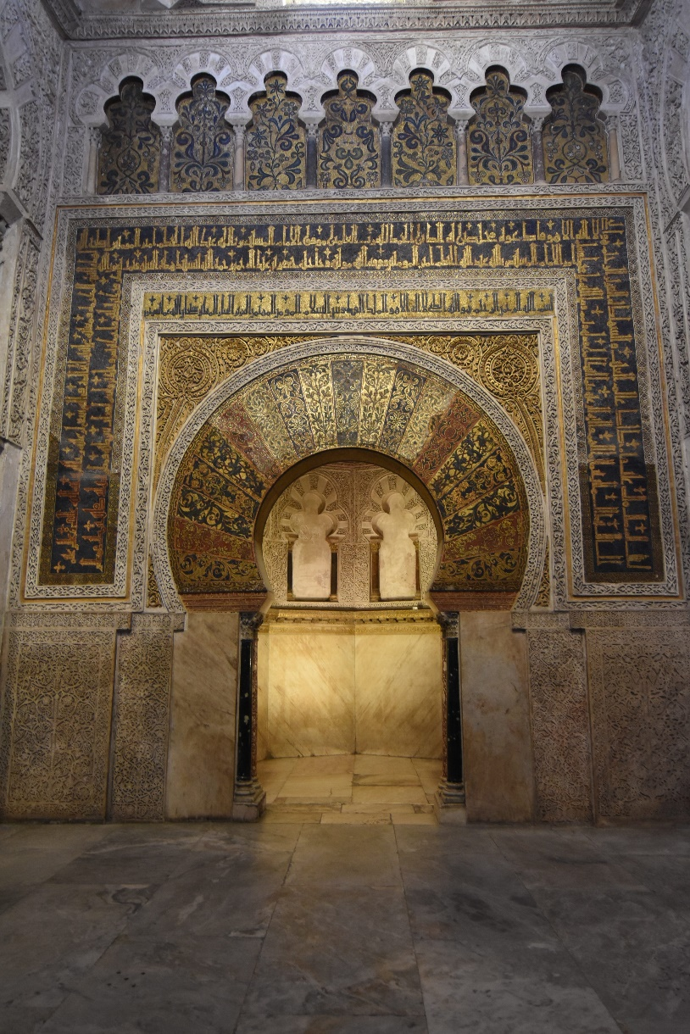
Mosque–Cathedral of Córdoba
The mihrab or prayer niche, framed by a horseshoe arch decorated with gold and color tesserae (small colored pieces of glass).

Slide 7
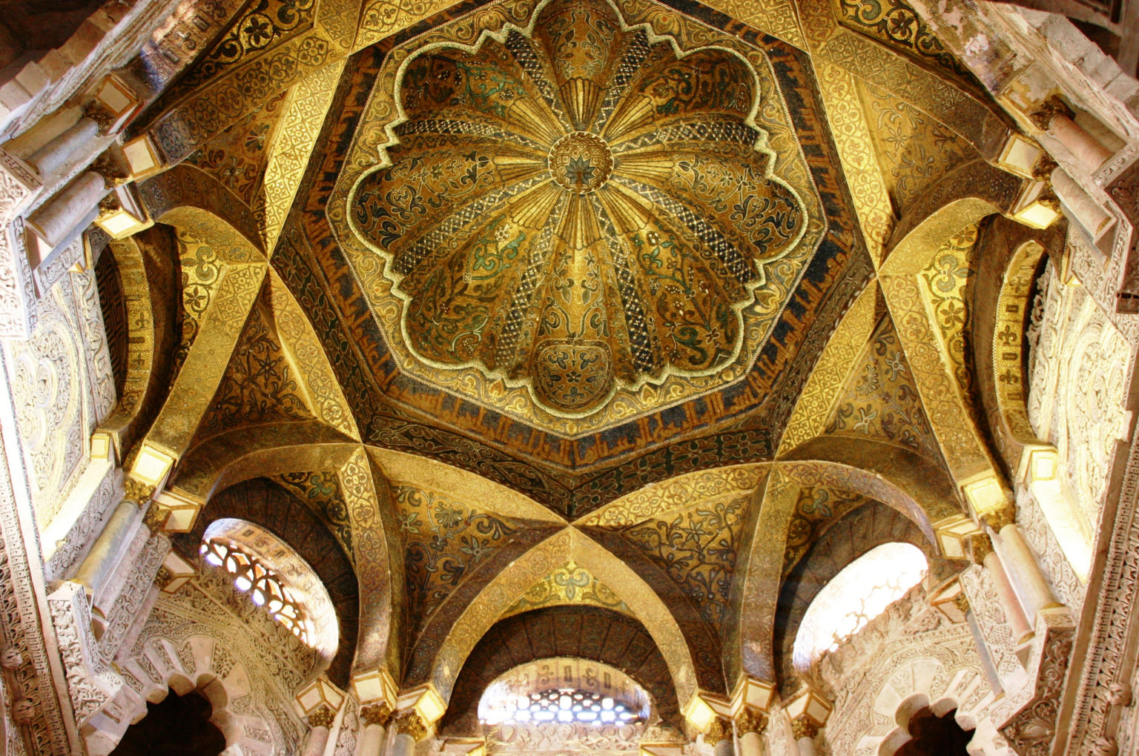
Mosque–Cathedral of Córdoba
Dome built above the mihrab

Slide 8
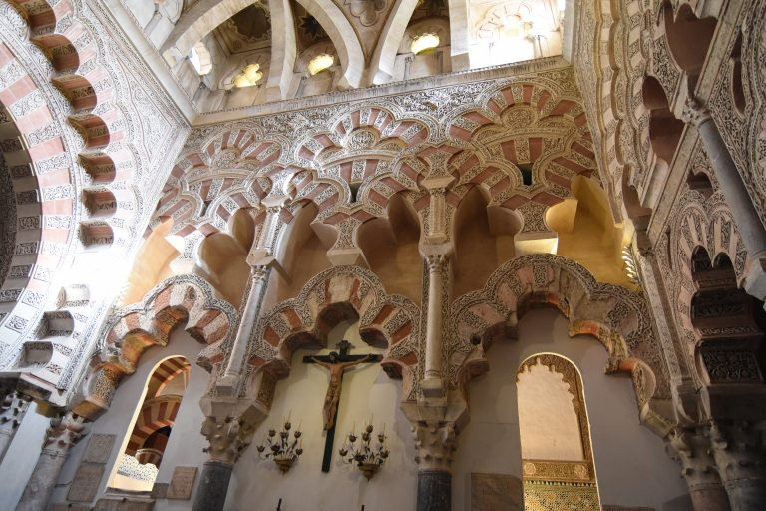
Mosque–Cathedral of Córdoba
Cathedral

Slide 9
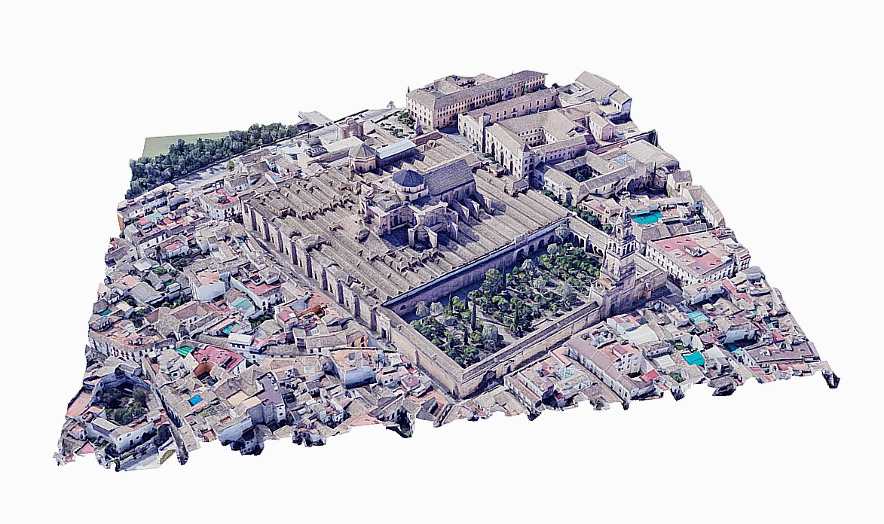
Mosque–Cathedral of Córdoba
Some of the 3D models available for The Mosque–Cathedral of Córdoba are:

Slide 10
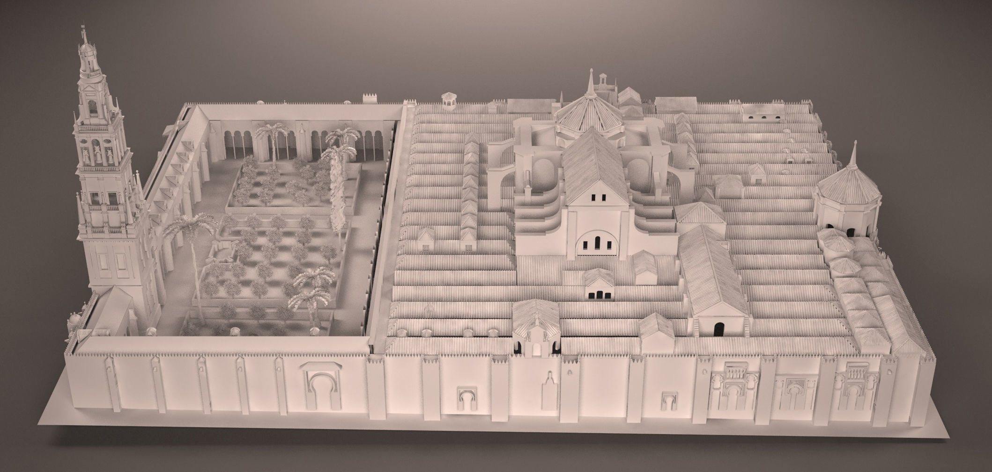
Mosque–Cathedral of Córdoba

Slide 11
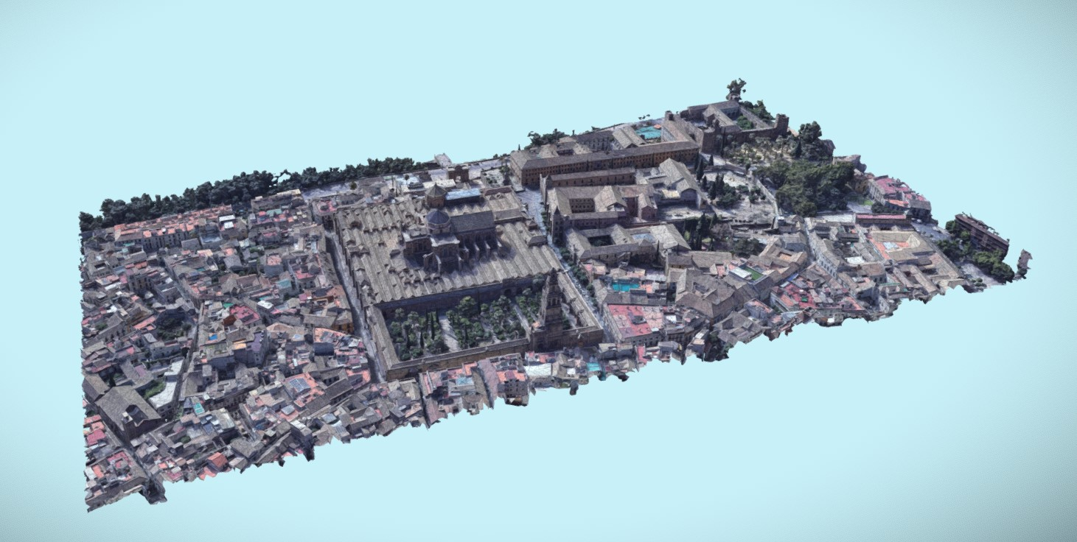
Mosque–Cathedral of Córdoba

Slide 12
Mosque–Cathedral of Córdoba
Most of the 3D models available are of the exterior of the architecture.

